Slide 1
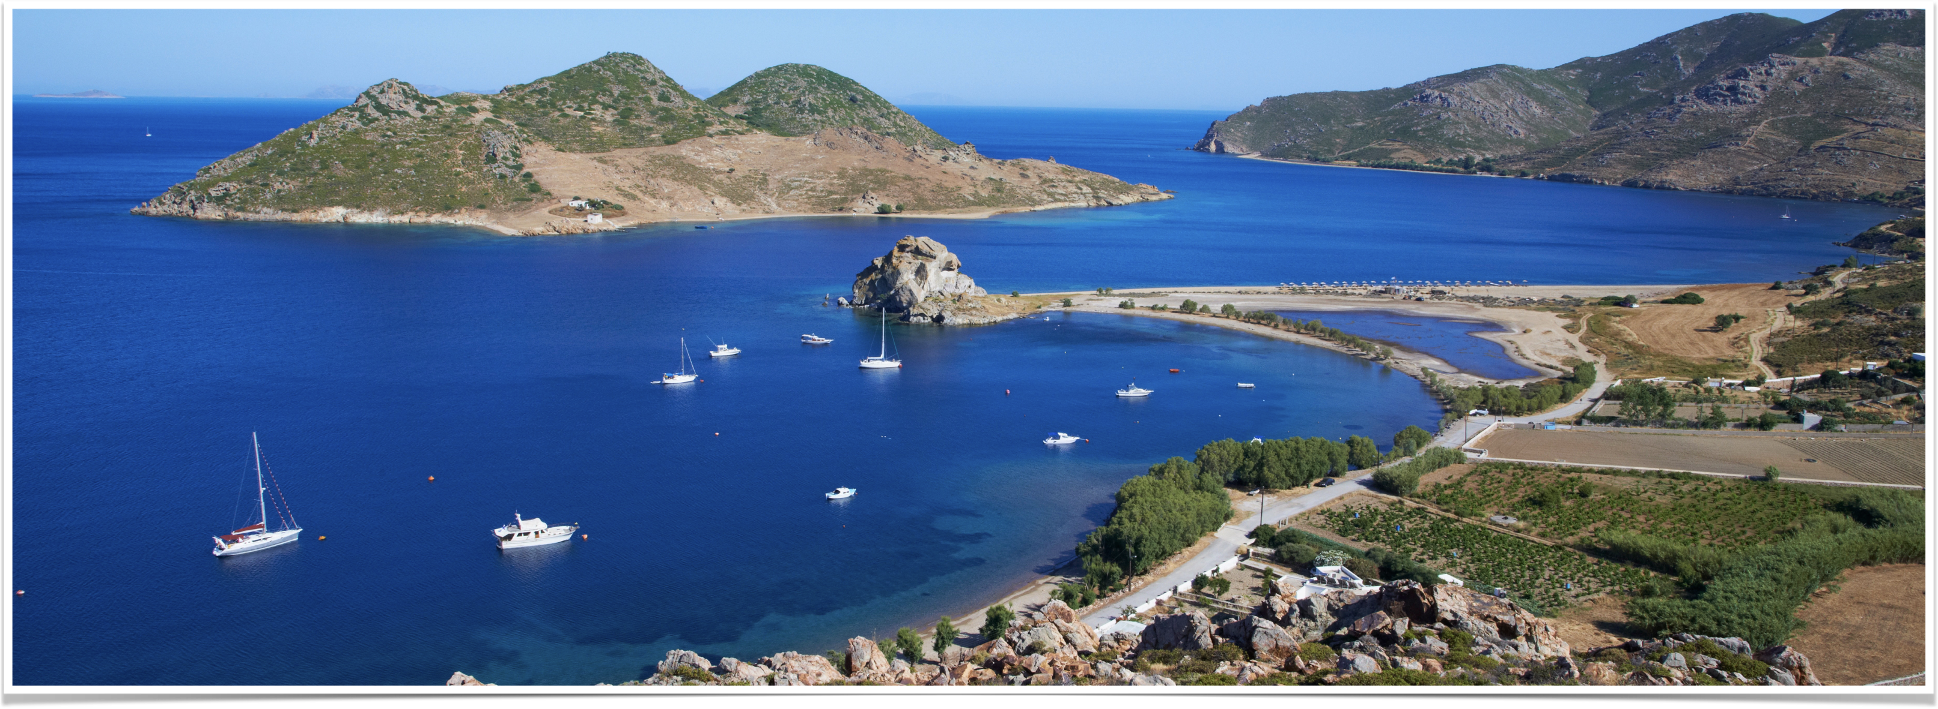
The Revelation of Jesus Christ
Vision 3, Part 2 (Revelation 12:13 - 13:2, Daniel 2 and 7, ) - The Dragon, the Woman, and the Beast

Slide 2
Summary of 12:1-12
God preserved a remnant of faithful Israelites who brought His Son into the world
Satan opposed Jesus and sought His life
The resurrection conquered Satan’s ultimate attempt at stopping Jesus
A heavenly battle paralleled the crucifixion; Satan lost and was cast to the earth
Jesus gives the faithful a strategy to overcome Satan
But Satan’s exile will mean trouble for those outside God’s kingdom
Notes:
God preserved a remnant of faithful Israelites who brought His Son into the world
Satan opposed Jesus and sought His life
The resurrection conquered Satan’s ultimate attempt at stopping Jesus
A heavenly battle paralleled the crucifixion; Satan lost and was cast to the earth
Jesus gives the faithful a strategy to overcome Satan
But Satan’s exile will mean trouble for those outside God’s kingdom

Slide 3
12:13-17: The dragon pursues the woman
Notes:
Revelation 12:13-17
13 Now when the dragon saw that he had been cast to the earth, he persecuted the woman who gave birth to the male Child.
14 But the woman was given two wings of a great eagle, that she might fly into the wilderness to her place, where she is nourished for a time and times and half a time, from the presence of the serpent.
15 So the serpent spewed water out of his mouth like a flood after the woman, that he might cause her to be carried away by the flood.
16 But the earth helped the woman, and the earth opened its mouth and swallowed up the flood which the dragon had spewed out of his mouth.
17 And the dragon was enraged with the woman, and he went to make war with the rest of her offspring, who keep the commandments of God and have the testimony of Jesus Christ.

Slide 4
The dragon’s assault on the church
“…when the dragon saw that he had been cast to earth, he persecuted the woman”
  He attacks Jesus indirectly (see Acts 9:4)
She is “given two wings of a great eagle that she might fly into the wilderness to her place, where she is nourished” — Exodus 19:4
Nourished for “time and times and half a time”
The serpent “spewed water out of his mouth” — see 17:15
Notes:
The dragon’s assault on the church
“when the dragon saw that he had been cast to the earth, he persecuted the woman”
He cannot attack Jesus directly, but he can attack Him indirectly by persecuting His people: “Saul, Saul, why are you persecuting Me?” (Acts 9:4)
The church would suffer his malice.
“given two wings of a great eagle that she might fly into the wilderness to her place, where she is nourished”
She would flee quickly by the aid of God like Israel escaping Egypt: “You have seen what I did to the Egyptians, and how I bore you on eagles' wings and brought you to Myself.” (Exodus 19:4)
As we turn through the pages of history, we find little or no mention of the first-century church – she existed but was protected in anonymity.
Faith in God was so rare in the days of Elijah that he was completely unaware 7,000 others were faithful to God.
Even if they do not appear on the pages of history, a remnant was always preserved, no matter if it was the time of Elijah or the church.
“time and times and half a time”
In verse 6, she is there for 1,260 days
“t, t, and ½ a t” = 1,260 days or 3.5 years
1,260 days = 1,260 years
12:15, “the serpent spewed water out of his mouth like a flood after the woman, that he might cause her to be carried away by the flood.”
According to 17:15, the waters “are peoples, multitudes, nations, and tongues”
The devil attempts to overwhelm the church by sheer numbers.
The devil will use the governments of the world in order to suppress, persecute, and annihilate the true church.

Slide 5
The earth helped the woman
The earth “opened its mouth and swallowed up the flood” — Exodus 15:12 and Numbers 16:31-32
2 Samuel 22:7, 17-18, “In my distress, I called upon the LORD, And cried out to my God; He heard my voice from His temple, And my cry entered His ears…[17] He sent from above, He took me, He drew me out of many waters. [18] He delivered me from my strong enemy, From those who hated me; for they were too strong for me.”
God works to protect and preserve His people
12:17, “the dragon was enraged with the woman”
Notes:
12:16, “the earth helped the woman” - God provides supernatural protection
12:16, “the earth opened its mouth and swallowed up the flood”
Moses, speaking about Pharaoh and his army, says in Exodus 15:12, “You stretched out Your right hand; the earth swallowed them.”
Numbers 16:31-32, “Now it came to pass, as he finished speaking all these words, that the ground split apart under them, [32] and the earth opened its mouth and swallowed them up, with their households and all the men with Korah, with all their goods.”
God saved His people from the threat of the Egyptians and the rebellion of Korah by swallowing the threat.
David praised God in 2 Samuel 22:7, 17-18, “In my distress, I called upon the LORD, And cried out to my God; He heard my voice from His temple, And my cry entered His ears…[17] He sent from above, He took me, He drew me out of many waters. [18] He delivered me from my strong enemy, From those who hated me; for they were too strong for me.”
Though Satan opposed the church, God’s providence worked in a multiplicity of ways to protect and preserve His people.
When the Jews began persecuting the church, God sent the gospel to the Gentiles.
Rome attempted to suppress the gospel and yet the church flourished.
And when the church was so corrupted by false teaching it was virtually unrecognizable, God preserved a faithful remnant intact.
12:17, “the dragon was enraged with the woman” – the church’s continued existence in spite of his best efforts infuriated Satan.

Slide 6
He makes war with the offspring
Offspring = those who “overcame him by the blood of the Lamb and by the word of their testimony, and they did not love their lives to the death.” (Revelation 12:11)
Contrasted with…
  Revelation 9:20-21, “But the rest of mankind, who were not killed by these plagues, did not repent of the works of their hands, that they should not worship demons, and idols of gold, silver, brass, stone, and wood, which can neither see nor hear nor walk. [21] And they did not repent of their murders or their sorceries or their sexual immorality or their thefts.”
  Revelation 13:8, “All who dwell on the earth will worship [the beast], whose names have not been written in the Book of Life of the Lamb slain from the foundation of the world.”
Notes:
Offspring = those who “overcame him by the blood of the Lamb and by the word of their testimony, and they did not love their lives to the death.” (Revelation 12:11)
Contrasted with…
Revelation 9:20-21, “But the rest of mankind, who were not killed by these plagues, did not repent of the works of their hands, that they should not worship demons, and idols of gold, silver, brass, stone, and wood, which can neither see nor hear nor walk. [21] And they did not repent of their murders or their sorceries or their sexual immorality or their thefts.”
Revelation 13:8, “All who dwell on the earth will worship [the beast], whose names have not been written in the Book of Life of the Lamb slain from the foundation of the world.”

Slide 7
Daniel 2 and 7

Slide 8
Nebuchadnezzar’s dream
A great image made of four metals and clay — gold, silver, bronze, iron and iron mixed with clay
Four kingdoms — Babylon, Medes and Persians, Greece, Rome
During the fourth kingdom God would establish another kingdom “which shall never be destroyed; and the kingdom shall not be left to other people; it shall break in pieces and consume all these kingdoms, and it shall stand forever.” (Daniel 2:44)
The kingdom of heaven, the church, would emerge in the days of the Roman Empire
Notes:
A great image made of four metals and clay — gold, silver, bronze, iron and iron mixed with clay
Four kingdoms — Babylon, Medes and Persians, Greece, Rome
During the fourth kingdom God would establish another kingdom “which shall never be destroyed; and the kingdom shall not be left to other people; it shall break in pieces and consume all these kingdoms, and it shall stand forever.” (Daniel 2:44)
The kingdom of heaven, the church, would emerge in the days of the Roman Empire

Slide 9
Daniel’s Four beasts
The first three beasts are comparable to animals — a lion, a bear, and a leopard
The fourth is not compared to any animal and is different than the first three
7:17 - the four beasts are the four kingdoms of Babylon, Medes/Persians, Greece, and Rome
Notes:
The first three beasts are comparable to animals — a lion, a bear, and a leopard
The fourth is not compared to any animal and is different than the first three
7:17 - the four beasts are the four kingdoms of Babylon, Medes/Persians, Greece, and Rome

Slide 10
The fourth beast = Rome
Teeth of iron, nails of bronze — a composite of Rome and Greece
Ten horns on its head
A little horn that speaks pompous words, persecutes and makes war with the saints, attempts to change times and law, prevails for time and times and half of time
The beast exists in some form until the Day of Judgment — Daniel 7:9-11
Notes:
Teeth of iron, nails of bronze — a composite of Rome and Greece
Ten horns on its head
A little horn that speaks pompous words, persecutes and makes war with the saints, attempts to change times and law, prevails for time and times and half of time
The beast exists in some form until the Day of Judgment — Daniel 7:9-11

Slide 11
Revelation 13:1-2: The Beast
Notes:
Revelation 13:1-2
1 Then I stood on the sand of the sea. And I saw a beast rising up out of the sea, having seven heads and ten horns, and on his horns ten crowns, and on his heads a blasphemous name.
2 Now the beast which I saw was like a leopard, his feet were like the feet of a bear, and his mouth like the mouth of a lion. The dragon gave him his power, his throne, and great authority.

Slide 12
A Beast Rises from the sea
Reminiscent of the four beasts in Daniel 7 who rose out of “the Great Sea”
Beast = a kingdom antagonistic to God and His people (Daniel 7:17, 23)
The sea = a vast multitude of people (Revelation 17:15, “The waters which you saw, where the harlot sits, are peoples, multitudes, nations, and tongues.”)
Notes:
Reminiscent of the four beasts in Daniel 7 who rose out of “the Great Sea”
Beast = a kingdom antagonistic to God and His people (Daniel 7:17, 23)
The sea = a vast multitude of people (Revelation 17:15, “The waters which you saw, where the harlot sits, are peoples, multitudes, nations, and tongues.”)

Slide 13
The beast described
He has “seven heads” = seven hills or seven kings (see Revelation 17:9-10)
“…ten horns” = ten kings (see Daniel 7:24)
“…ten crowns” = ten kingdoms established and granted authority by the beast (see Revelation 17:12)
“…on his heads a blasphemous name” = speaks evil of that which is high and holy
Notes:
John’s description of the beast.
“seven heads” seven mountains or seven kings (Revelation 17:9-10, “Here is the mind which has wisdom: The seven heads are seven mountains on which the woman sits. [10] There are also seven kings. Five have fallen, one is, and the other has not yet come. And when he comes, he must continue a short time.”)
“ten horns” -- 10 kings (Daniel 7:24, “The ten horns are ten kings Who shall arise from this kingdom. And another shall rise after them; He shall be different from the first ones, And shall subdue three kings.”)
“ten crowns” -- 10 kingdoms established and granted authority by the beast (Revelation 17:12, “The ten horns which you saw are ten kings who have received no kingdom as yet, but they receive authority for one hour as kings with the beast.”)
“on his heads a blasphemous name” speak evil of that which is high and holy

Slide 14
A composite
“leopard” – Greece
“feet were like the bear” – Persia
“mouth of a lion” – Babylon
Daniel 7:19 — “teeth of iron” (Rome) and “nails of bronze” (Greece)
The body of the beast is a composite of these ancient empires.
Notes:
“the beast which I saw was like a leopard, his feet were like the feet of a bear, and his mouth like the mouth of a lion”
“leopard” – Greece
“feet were like the bear” – Persia
“mouth of a lion” – Babylon
Daniel 7:19 — “teeth of iron” (Rome) and “nails of bronze” (Greece)
The body of the beast is a composite of these ancient empires.

Slide 15
The number of the beast
6 is the number of mankind — Adam and Eve were created on the sixth day
The book is written in Greek
Greeks used letters to symbolize numbers
Irenaeus proposed a solution in the second century when he wrote, “It seems to me very probable; for this is a name of the last of Daniel's four kingdoms; they being Latins that now reign.”
Notes:
6 is the number of mankind — Adam and Eve were created on the sixth day
The book is written in Greek
Greeks used letters to symbolize numbers
Irenaeus proposed a solution in the second century when he wrote, “It seems to me very probable; for this is a name of the last of Daniel's four kingdoms; they being Latins that now reign.”

Slide 16

IRENAEUS’S SOLUTION
L | A | T | E | I | N | O | S | TOTAL
30 | 1 | 300 | 5 | 10 | 50 | 70 | 200 | 666

Slide 17
REASONS WHY LATEINOS MAKES SENSE
Rome is the last kingdom in Daniel and Nebuchadnezzar’s visions
The fourth beast in Daniel 7 and the beast in Revelation 13 correspond
  Both composites
  Both are “incomparable”
  Both have 10 horns
Revelation 17:10, “There are also seven kings. Five have fallen, one is, and the other has not yet come. And when he comes, he must continue a short time.”
Notes:
As Irenaeus points out, this identification correlates with the fourth kingdom of Daniel 7.
The first kingdom was Babylon, the second Medo-Persia based on Daniel 2:37-39 and 5:31.
Daniel also tells us that Greece conquered the Persians – the imagery and its angelic interpretations in chapters 8 and 11:2-4 tells us this plainly.
The only kingdom which qualifies as a legitimate, historical successor to the Greeks is the Roman empire: this historical succession is indisputable and is illustrated by the imagery of Daniel 7 (Babylon – Persia – Greece - Rome).
Like the first beast of Revelation 13, the fourth beast of Daniel 7 – Rome – possesses 10 horns which symbolize in both instances 10 kings or kingdoms.
As the angel points out, this kingdom ruled in the time of John (five heads had fallen, one was contemporaneous with John, 2 awaited in the future), and the eighth – the beast itself – was, “of the seven”, they were linked in both character and succession.

Slide 18
“Seven heads”
Seven heads, single body: see Daniel 7:6
17:10, “five have fallen”: 5 phases of Roman power had passed
  Tacitus: kings, consuls, dictators, decemvirs (council of 10), military tribunes
17:10, “one is”: contemporaneous with John, the pagan emperors from Augustus - Aurelian
17:10, “one has not yet come”: the governmental reforms of Diocletian and Constantine
17:10, the seventh will only “continue a short time”: approximately 150 years
Notes:
Seven heads with a single body.
In Daniel 7:6, the leopard – which represents Greece – has four heads on a single body, which represents four divisions of power within a single kingdom (Four Greek generals who divided Alexander's kingdom after the battle of Ipsus: Cassander, Lysimachus, Seleucus, Ptolemy).
Since this beast represents the Roman or Latin empire, then the seven heads must represent seven manifestations or divisions of Roman power.
According to 17:10, “five have fallen”: by John's time, five different types of Roman rule had passed into history.
“When Rome was first a city, its rulers were kings. Then Lucius Junius Brutus created the consulate and free Republican institutions in general. Dictatorships were assumed in emergencies. A Council of Ten did not last more than two years; and then there was a short-lived arrangement by which senior army officers – the commanders of contingents provided by the tribes – possessed consular authority.” – Cornelius Tacitus, The Annals of Imperial Rome, p. 31
Tacitus essentially lists 5 phases or manifestations of Roman rule:
Kings: the founding of Rome – 508 B.C.
Consuls or Consulates: leaders of the Republic, taken from among the aristocracy
Dictators: appointed in times of crisis, carried all the power of a king, appointed for a term of 6 months.
Decemvirs: a council of 10, appointed for two years (451-449), empowered to rewrite Roman law
Military tribunes: chosen from among the plebeians, exercised consular authority but restrict from the consular title due to lowly heritage.
These were the five heads that had fallen by John's day.
17:10 also tells us that, “one is.”
Or, one is ruling as this letter is revealed, contemporary with John's time.
This head represents the Roman emperors beginning with Augustus and ending with Aurelian (282 A.D.).
As Tacitus notes, this took some time to develop, with several attempts made by various men.
But by John’s day, the Roman emperors had been firmly in place for over 100 years.
17:10 concludes, “the other has not yet come. And when he comes, he must continue a short time”: this represents the government constituted by Diocletian and completed by Constantine.
For the better part of a century, Rome was embroiled in civil war and times of outright anarchy – we see this represented in seals 2-4.
“Like Augustus...[Diocletian] may be considered as the founder of a new empire.” – Gibbon, Decline and Fall, I.XIII.309
Constantine succeeded Diocletian and continued, “in the main, the broad lines drawn by Diocletian, so that his work may be regarded as a continuation of that of his predecessor.” – Meyers, Ancient History, p. 528
The council of Nice in 325, convened by order of the emperor Constantine, “marked the replacement of paganism with Christianity as the religious expression and support of the Roman Empire...A new civilization, based on a new religion, would now rise over the ruins of an exhausted culture and a dying creed.” – Durant, Caesar and Christ, p. 661
17:10 says the seventh head would only “continue a short time” - this seventh phase of Roman government would only last about 150 years.

Slide 19
A blasphemous name
Roman emperors were often deified by the public, “As early as 36 B.C. some Italian cities had given Octavian (Caesar Augustus) a place in their pantheon; by 27 B.C. his name was added to those of the gods in official hymns at Rome; his birthday became a holy-day as well as a holiday; and after his death the Senate decreed that his genius, or soul, was thereafter to be worshiped as one of the official divinities.” – Durant, Caesar and Christ, p. 226
Diocletian “developed the cult of the Emperor's genius into a personal worship of himself as the earthly embodiment of Jupiter...wisdom and force had come down from heaven to restore order and peace on earth…” — Durant, Caesar and Christ, pp. 640-641
Notes:
Roman emperors were often deified by the public, “As early as 36 B.C. some Italian cities had given Octavian (Caesar Augustus) a place in their pantheon; by 27 B.C. his name was added to those of the gods in official hymns at Rome; his birthday became a holy-day as well as a holiday; and after his death the Senate decreed that his genius, or soul, was thereafter to be worshiped as one of the official divinities.” – Durant, Caesar and Christ, p. 226
Religion and state tied together deeply in the ancient world
Augustus attempted to revive the Roman religion as a part of his reforms
Diocletian “developed the cult of the Emperor's genius into a personal worship of himself as the earthly embodiment of Jupiter...wisdom and force had come down from heaven to restore order and peace on earth…” — Durant, Caesar and Christ, pp. 640-641

Slide 20
Seven heads summary
Five have fallen (listed by Tacitus): Kings, Consuls, Dictators, Decemvirs, and Military tribunes.
One is: the Roman Emperors from Augustus to Aurelian
One is yet to come: the reorganized empire started by Diocletian and completed by Constantine.
Blasphemous names: integration of religion and state first under the pagan religion of Rome.
Notes:
Five have fallen (listed by Tacitus): Kings, Consuls, Dictators, Decemvirs, and Military tribunes.
One is: the Roman Emperors from Augustus to Aurelian
One is yet to come: the reorganized empire started by Diocletian and completed by Constantine.
Blasphemous names: integration of religion and state first under the pagan religion of Rome.

Slide 21
Ten horns = ten kingdoms
Daniel 7:24, “The ten horns are ten kings who shall arise from this kingdom.”
Revelation 17:12-14, “The ten horns which you saw are ten kings who have received no kingdom as yet, but they receive authority for one hour as kings with the beast. (13) These are of one mind, and they will give their power and authority to the beast. (14) These will make war with the Lamb, and the Lamb will overcome them, for He is Lord of lords and King of kings; and those who are with Him are called, chosen, and faithful.”
Notes:
Daniel 7:24, “The ten horns are ten kings who shall arise from this kingdom.”
Revelation 17:12-14, “The ten horns which you saw are ten kings who have received no kingdom as yet, but they receive authority for one hour as kings with the beast. (13) These are of one mind, and they will give their power and authority to the beast. (14) These will make war with the Lamb, and the Lamb will overcome them, for He is Lord of lords and King of kings; and those who are with Him are called, chosen, and faithful.”

Slide 22
Conclusions
The 10 horns will arise out of the Roman Empire.
They were not in power in John's day – “who have received no kingdom yet”.
They will rule separately from the beast for a short while, but will eventually surrender their authority to the beast – “but they receive authority for one hour with the beast...and they will give their power and authority to the beast”
They will make war with Jesus by persecuting His saints – we will consider this further in 13:7
Notes:
The 10 horns will arise out of the Roman Empire.
They were not in power in John's day – “who have received no kingdom yet”.
They will rule separately from the beast for a short while, but will eventually surrender their authority to the beast – “but they receive authority for one hour with the beast...and they will give their power and authority to the beast”
They will make war with Jesus by persecuting His saints – we will consider this further in 13:7

Slide 23
The rise of the European powers
“If one were writing the history of Western Europe in the period from about 330-700 AD, there would, inevitably be two major themes. The first would tell of the late Roman empire and its fate after the reorganization by the Emperors Diocletian and Constantine, until most of its Western provinces were superseded by barbarian kingdoms. The second theme would be the story of these new nations, the Germanic kingdoms whose foundations were laid during the years from about 400-600 AD.” - The Oxford Illustrated History of Christianity, p. 62
“Historically, the conquest destroyed the outward form of what had already inwardly decayed; it cleared away with regrettable brutality and thoroughness a system of life which, with all its gifts of order, culture, and law, had worn itself into senile debility, and had lost the powers of regeneration and growth. A new beginning was now possible: the Empire of the West faded, but the states of modern Europe were born.” - Durant, The Age of Faith, p. 43
Notes:
Beginning a few centuries before Christ, Teutonic (Germanic) tribes migrated west out of Asia, settling in north-central Europe.
When the Roman Empire sought to push its borders northward into Europe, it found numerous hosts of Germanic tribes pushed west by the Huns in search of new lands.
As the Empire decayed from within, these tribes grew stronger; eventually, the weakened Empire could hold them back no longer: beginning in 410 A.D., Rome was invaded and sacked by a succession of Germanic tribes; in 476, she was finally conquered (Trumpets 1-4).
The rise of these Germanic powers corresponds with Daniel 7:24's description, “The ten horns are ten kings Who shall arise from this kingdom.”
From these Germanic powers rose the royal bloodlines and nationalities which would one day lead to our modern European countries.

Slide 24
A succession of kingdoms
Babylon: the head of gold and the lion
Persia: the arms and chest of silver, the bear, and the ram
Greece: the leopard, the thighs of bronze, and the male goat
Rome: the legs and feet mixed of iron and clay, the fourth indescribable beast
Each nation became, “spoil for their servants” (Zechariah 2:9): each empire fell victim to the one which followed.
Notes:
Babylon: the head of gold and the lion
Persia: the arms and chest of silver, the bear, and the ram
Greece: the leopard, the thighs of bronze, and the male goat
Rome: the legs and feet mixed of iron and clay, the fourth indescribable beast
Each nation became, “spoil for their servants” (Zechariah 2:9): each empire fell victim to the one which followed.

Slide 25
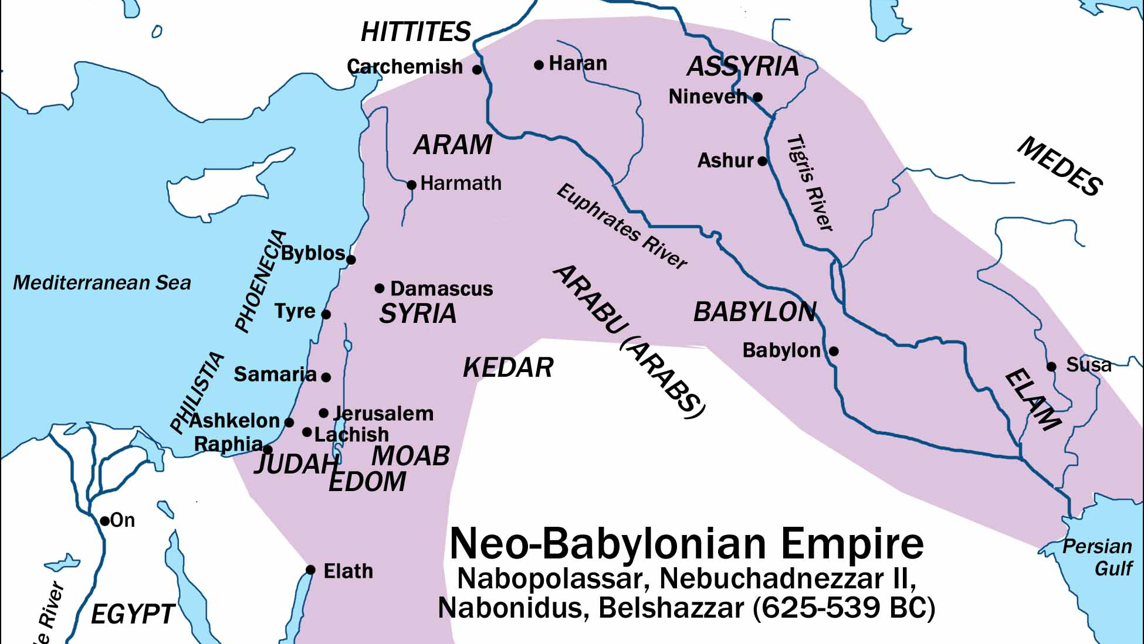

Slide 26
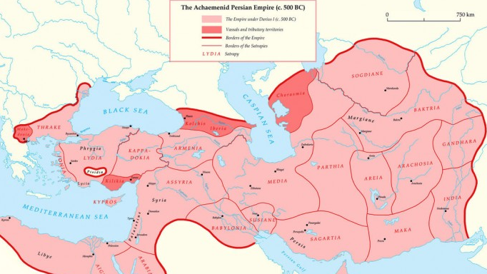

Slide 27
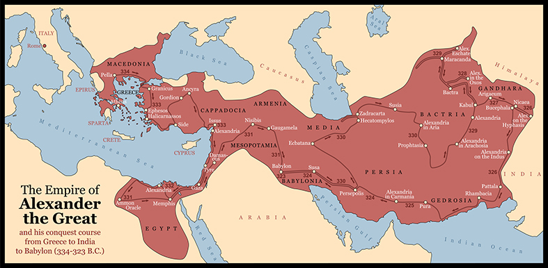

Slide 28
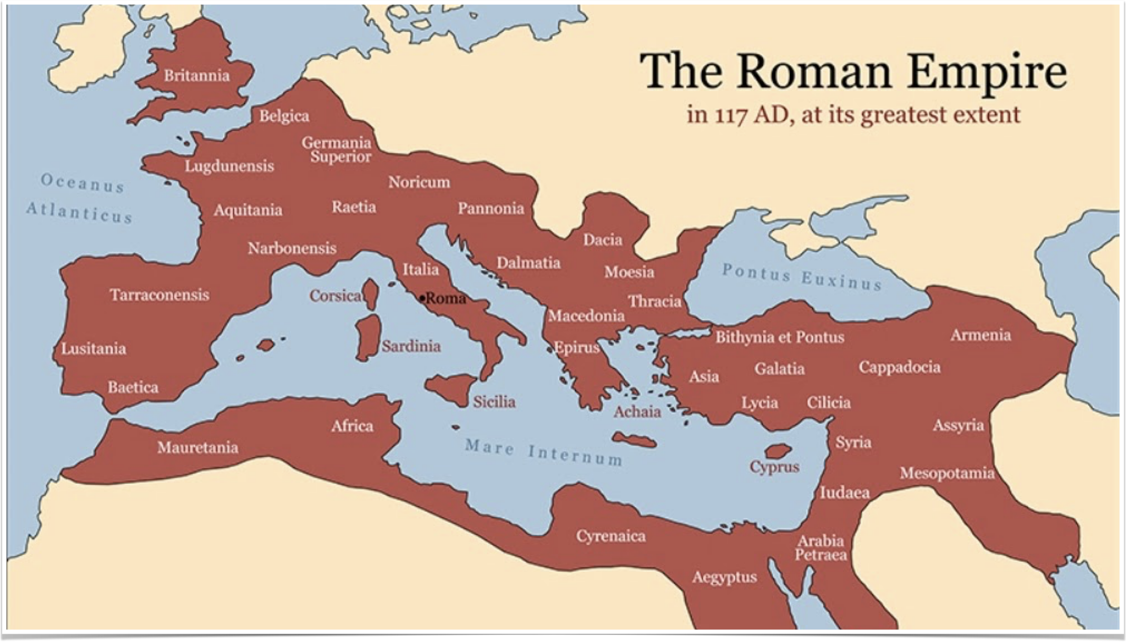

Slide 29
Civilization migrates
“Civilization does not die, it migrates; it changes its habitat and its dress, but it lives on. The decay of one civilization, as of one individual, makes room for the growth of another; life sheds the old skin, and surprises death with fresh youth.” – Durant, The Life of Greece, p. 670
Babylon influenced Persia who influenced Greece who influenced Rome
13:2, “the beast which I saw was like a leopard, his feet were like the feet of a bear, and his mouth like the mouth of a lion”
Notes:
“Civilization does not die, it migrates; it changes its habitat and its dress, but it lives on. The decay of one civilization, as of one individual, makes room for the growth of another; life sheds the old skin, and surprises death with fresh youth.” – Durant, The Life of Greece, p. 670
Babylon influenced Persia who influenced Greece who influenced Rome
13:2, “the beast which I saw was like a leopard, his feet were like the feet of a bear, and his mouth like the mouth of a lion”

Slide 30
Summary of 12:13-13:2
Satan, the dragon, will make war against the church using all means at his disposal.
Rome was a manifestation of Satan’s power and was Satan’s tool to use in persecution of the church.
Rome itself was a composite of earlier kingdoms having conquered and assimilated the nations and cultures of those more ancient empires.
Out of the fall of the Roman Empire would emerge the kingdoms of Europe.
Notes:
Satan, the dragon, will make war against the church using all means at his disposal.
Rome was a manifestation of Satan’s power and was Satan’s tool to use in persecution of the church.
Rome itself was a composite of earlier kingdoms having conquered and assimilated the nations and cultures of those more ancient empires.
Out of the fall of the Roman Empire would emerge the kingdoms of Europe.

